Slide 1
資訊安全與人工智慧
資電優勢論壇 2019
黃世昆 Shih-Kun Huang
National Chiao Tung University
<skhuang@cs.nctu.edu.tw>

Slide 2

AIoT of Security AIoT +X Security of AIoT X + AIoT

Slide 3
資訊安全與人工智慧的關係
AI of Security
運用人工智慧的技術解決資訊安全的議題
Neural Symbolic Execution
Neural Fuzzing
CNN based Malware Detection
Domain Generation Algorithm (DGA)
破解 CAPTCHA
Security of AI
檢測人工智慧的安全問題
擾亂錯誤判別
目標導向錯誤判別控制
強化所訓練模型
模型偷竊

Slide 4
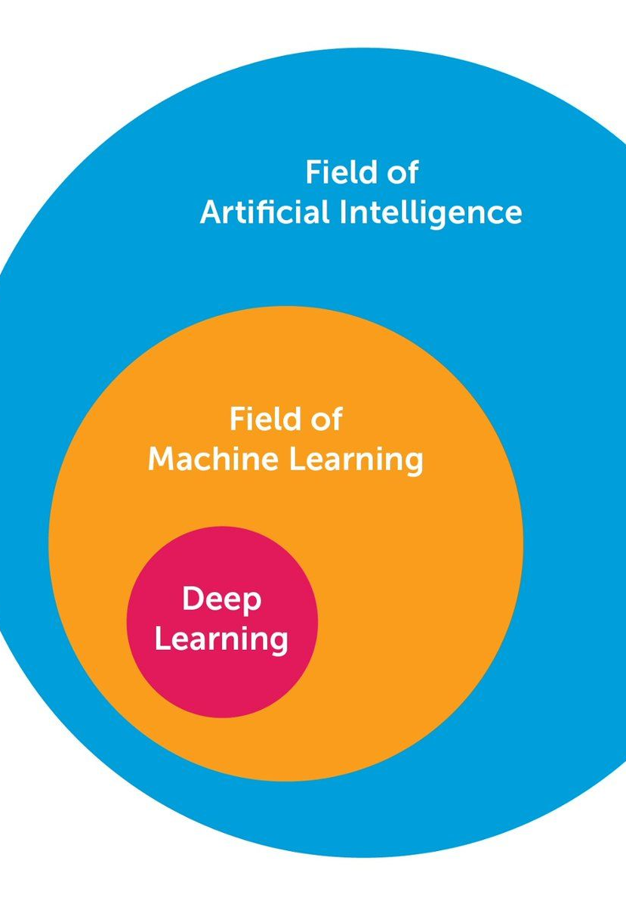
Artificial Intelligence 人工智慧
Machine Learning
Deep Learning

Slide 5
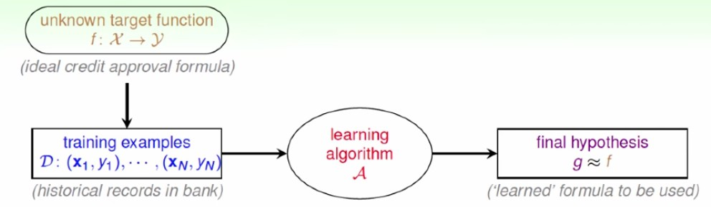
Machine Learning

Slide 6
深度神經網路
深度神經網路 (Deep Neural Networks, DNN)
定義
多層神經網路 (Neural Network, NN)
變形
卷積神經網路 (Convolutional Neural Networks, CNN)
圖像分析
遞歸神經網路 (Recurrent Neural Networks, RNN)
語意分析

Slide 7
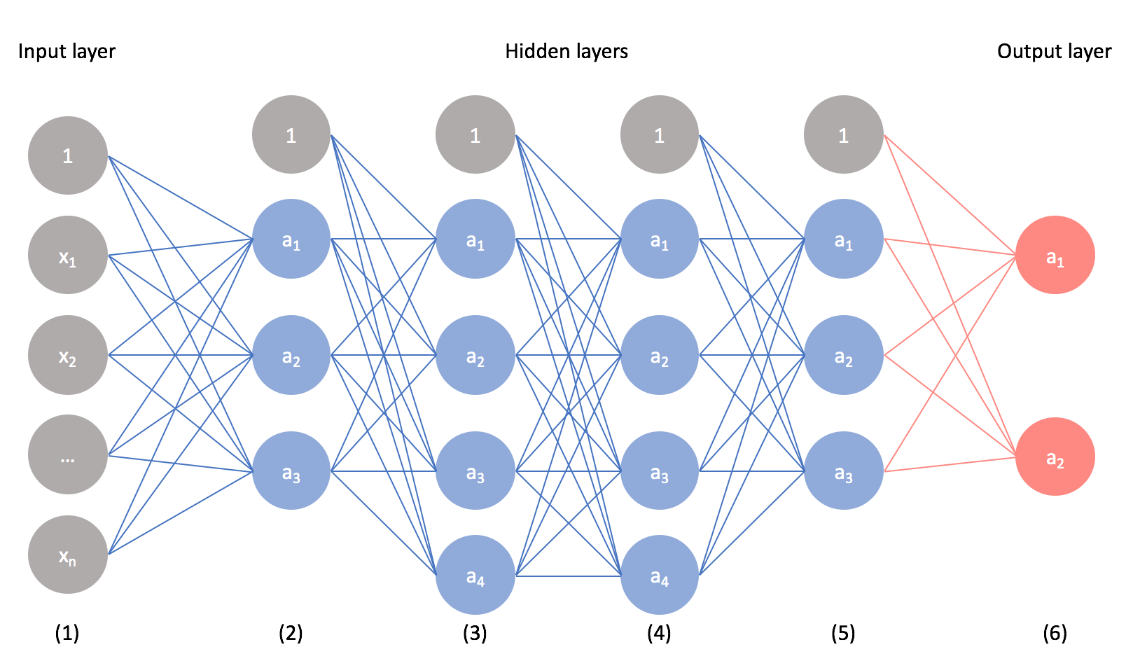
Neural Networks and Deep Learning

Slide 8
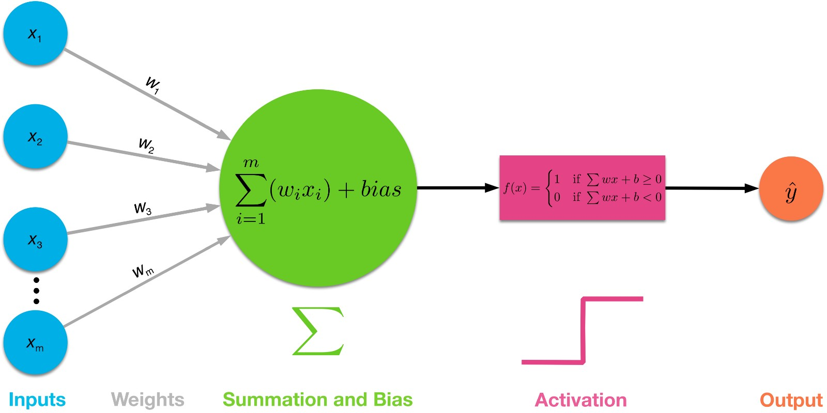
Neural Networks and Deep Learning

Slide 9
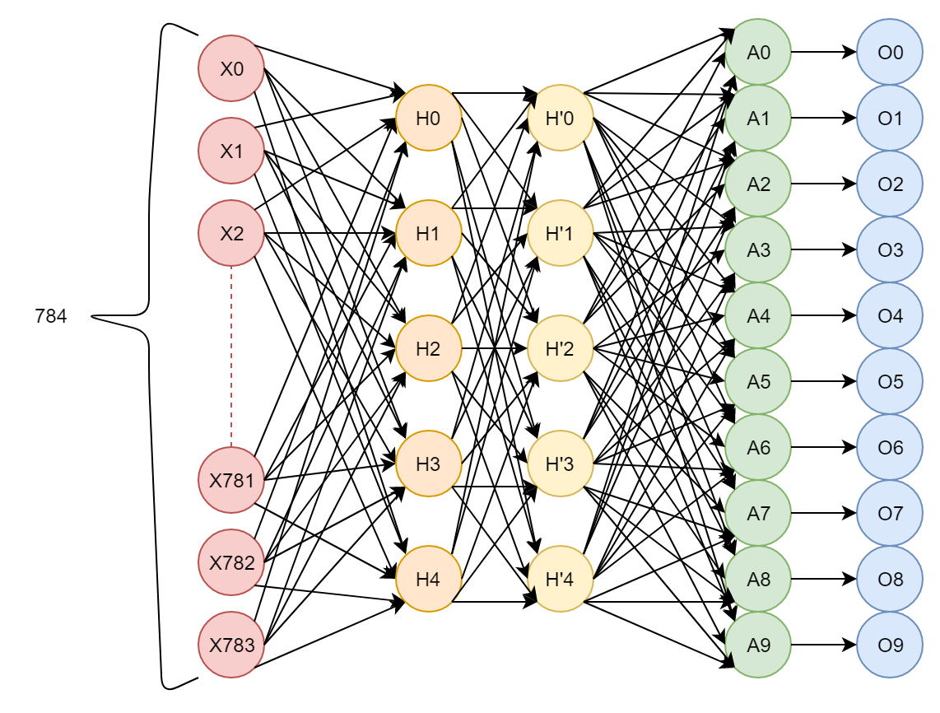
深度神經網路
全連接層 (fully connected layer)
Y=WX+b
激勵層 (activation layer)
增加梯度
輸出層 (output layer)
選取最大機率值
卷積層 (convolution layer)
尋找獨特特徵
池化層 (pooling layer)

Slide 10
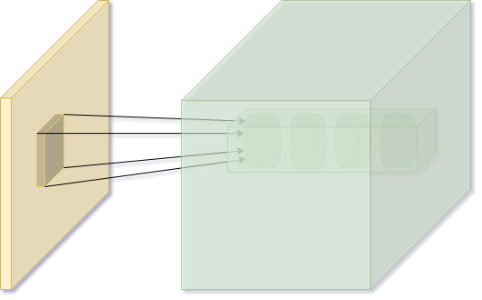
深度神經網路
全連接層 (fully connected layer)
Y=WX+b
激勵層 (activation layer)
增加梯度
輸出層 (output layer)
選取最大機率值
卷積層 (convolution layer)
尋找獨特特徵
池化層 (pooling layer)

Slide 11
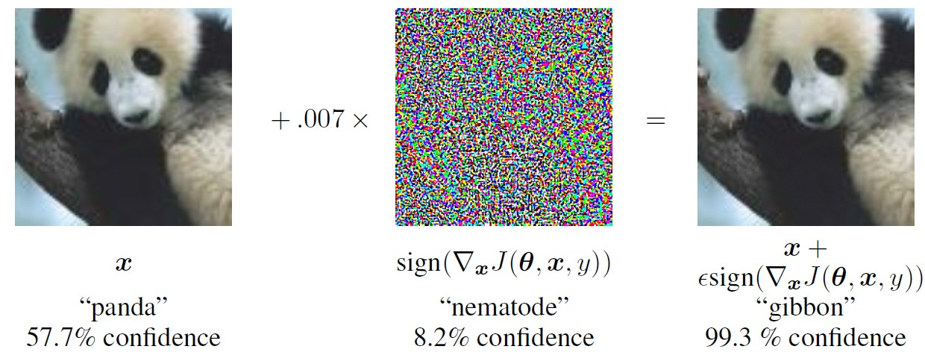
Adversarial Attack
Adversarial examples are inputs to machine learning models that an attacker has intentionally designed to cause the model to make a mistake

Slide 12
NIST 資訊安全的框架
Identify
Identify 識別
準備
Protect
Protect 保護
事前
Detect
Detect 偵測
事發
Respond
Respond回應
事後
Recover
Recover 復原
事終

Slide 13
攻擊的框架
對應 (Map)
測試 (Test)
利用 (Exploit)
隱藏 (Mitigation)
Post-Exploitation
控制 (C&C)

Slide 14
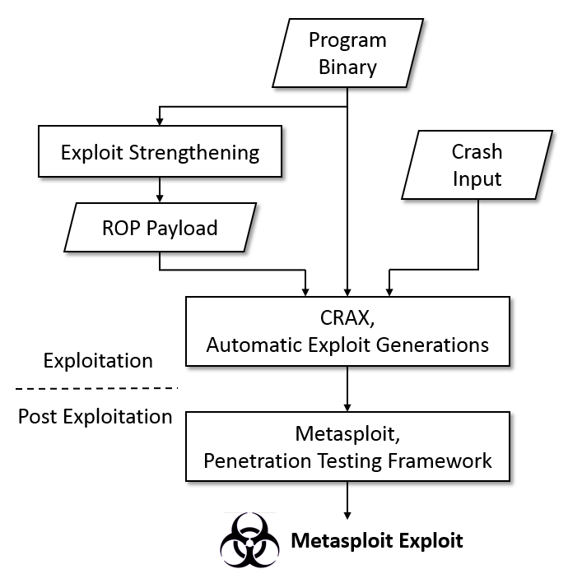
NIST Framework of Attack
Fuzzer
Target-aware Symbolic Fuzzing
Automatic Exploit Generation
Anti-Mitigation Payload Generation
Post Exploitation Integration
映、測、脅、隱、控

Slide 15
防禦的框架
對應 (map)
測試 (test)
定位 (locate)
修補 (fix)
清除 (clear)

Slide 16
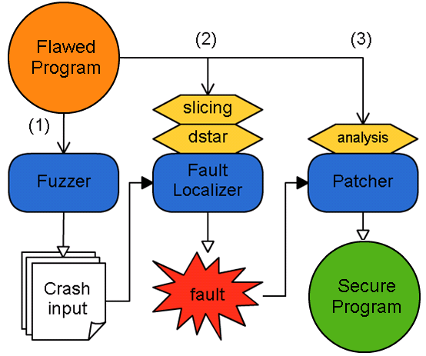
NIST Framework of Defense
Fault Localization (path)
Data Slicing (data)
Patching Site Isolation
映、測、修、補、清

Slide 17
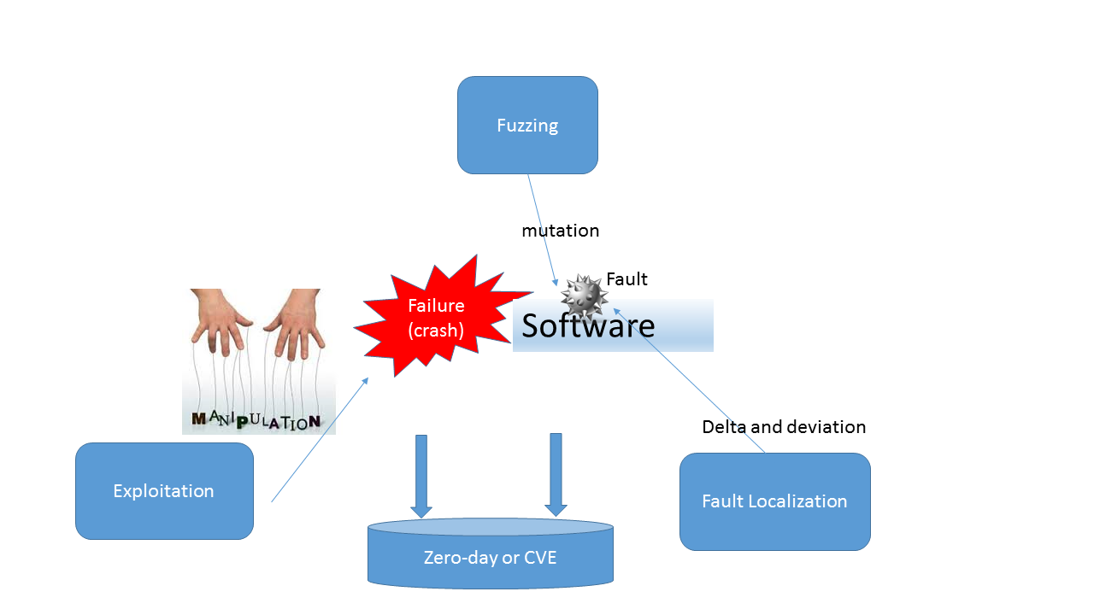
Software Exploitation Framework
Pre-Exploitation
Peri-Exploitation
End-Exploitation
Post-Exploitation
security auditing tools (nessus, metasploit, sqlmap)
developer bug forensic tools

Slide 18
AI of Security (I)
以人工智慧處理資訊安全議題 －
基於機器學習之符號執行路徑探索機制

Slide 19
基於機器學習之符號執行路徑探索機制 Machine Learning-based Path Exploration for Symbolic Execution

Slide 20
Automated Vulnerability Discovery
Fuzzing
Randomly create inputs to test the program and check whether there is a bug or not
Symbolic Execution
When a program is symbolically executed, it will be provided a symbolic value for each input, instead of concrete inputs

Slide 21
Symbolic Execution
Dynamic analysis
Set symbolic values and constraints
When symbolic engine encounter branch, it will fork and create related path
Concretize to obtain a possible value

Slide 22
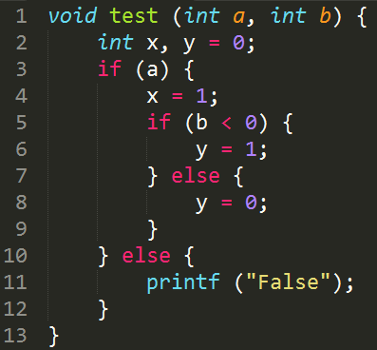
Example for Symbolic Execution
The variable a and b will be replaced by symbolic value

Slide 23
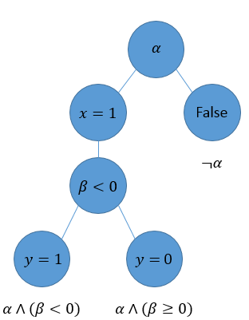
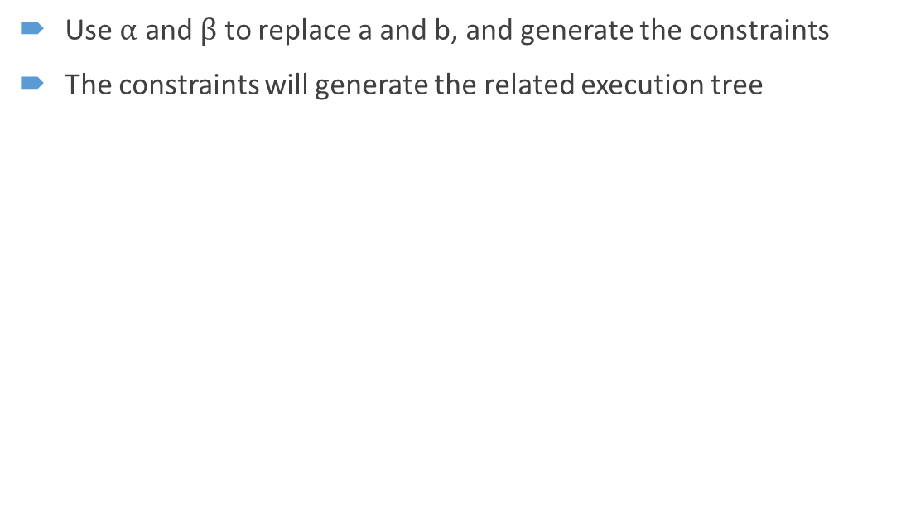
Related Execution Tree
Use $α$ and $β$ to replace a and b, and generate the constraints
The constraints will generate the related execution tree

Slide 24
Problem Description
Path exploration
The size of the execution tree grows exponentially in the number of conditions
How to select the path efficiently

Slide 25
Motivation
DFS is a fixed order tree search method
Dynamically select expandable node of the execution tree by using machine learning-based methods
We hope to have an intelligent search method to better improve the accuracy

Slide 26
Objective
Add an influential factor to improve the accuracy of selecting expandable node
Propose different strategies to make the selection better
Find more code blocks than DFS and faster

Slide 27
Monte Carlo Tree Search
A heuristic search algorithm for some turned-based games AI, like Tic Tac Toe, Reversi, Chess
The purpose is for some kinds of decision processes

Slide 28
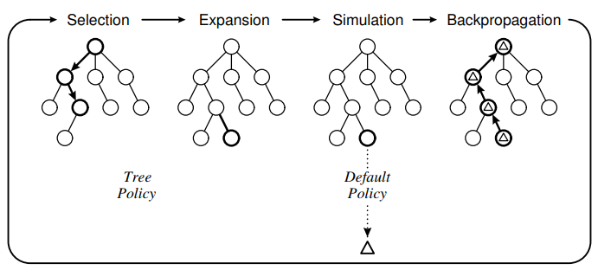
One iteration of MCTS approach

Slide 29
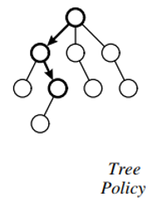
Selection
Start from the root of the tree
Recursively find the best child until find the expandable node
Tree policy
How to select the best child

Slide 30
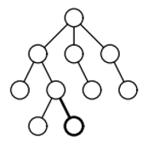
Expansion
Add the new child to expand the tree

Slide 31
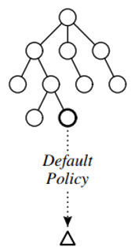
Simulation
It will run from the new node
Default policy
How to simulate

Slide 32
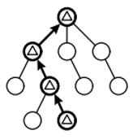
Backpropagation
The simulation result will be backed up through the selected nodes
The statistic information will be updated

Slide 33
Multi-armed bandit problem
A gambler has to decide which machines to play
Exploration: get the information about expected playoffs of the machine
Exploitation: find the highest expected playoff
The trade-off of the exploration and exploitation is a problem
Notes:
Exploration: 探索
Exploitation: 開發

Slide 34
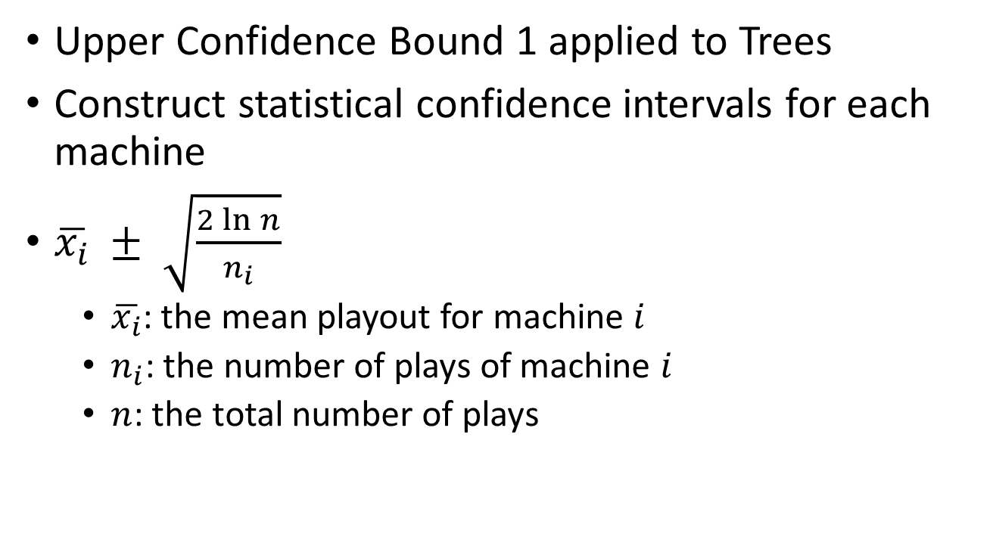
UCT
Upper Confidence Bound 1 applied to Trees
Construct statistical confidence intervals for each machine
$\overline{x_{i}} ± \sqrt{\frac{2\ln{n}}{n_{i}}}$
$\overline{x_{i}}$: the mean playout for machine $i$
$n_{i}$: the number of plays of machine $i$
$n$: the total number of plays

Slide 35
Related Work
DPP
Dynamic Path Pruning
Reduce path constraint resolution time in symbolic execution
KLEE
A symbolic virtual machine built on top of the LLVM compiler infrastructure
Select a path which is likely cover new code in the immediate future

Slide 36
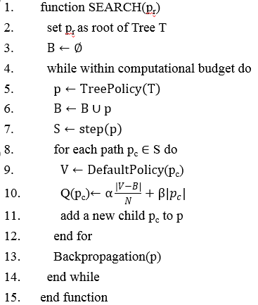
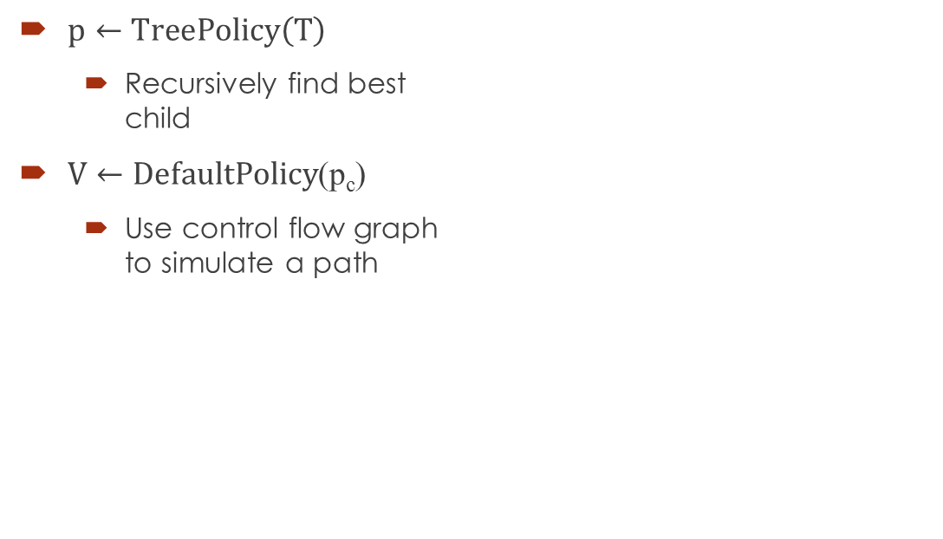
MCTS Algorithm
$p←TreePolicy\left(T\right)$
Recursively find best child
$V←DefaultPolicy$(p_{c})
Use control flow graph to simulate a path

Slide 37
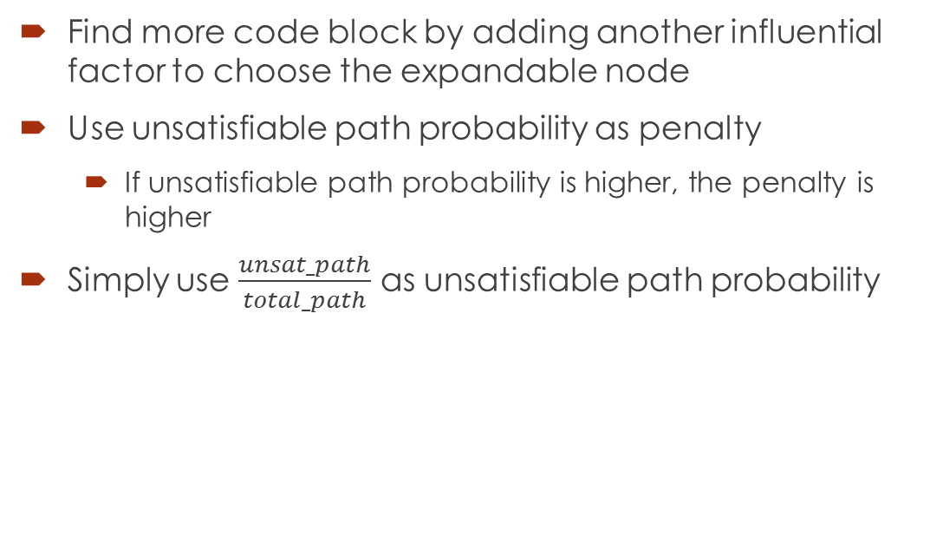
Improve by penalty
Find more code block by adding another influential factor to choose the expandable node
Use unsatisfiable path probability as penalty
If unsatisfiable path probability is higher, the penalty is higher
Simply use $\frac{unsat_path}{total_path}$ as unsatisfiable path probability

Slide 38
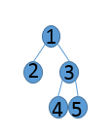
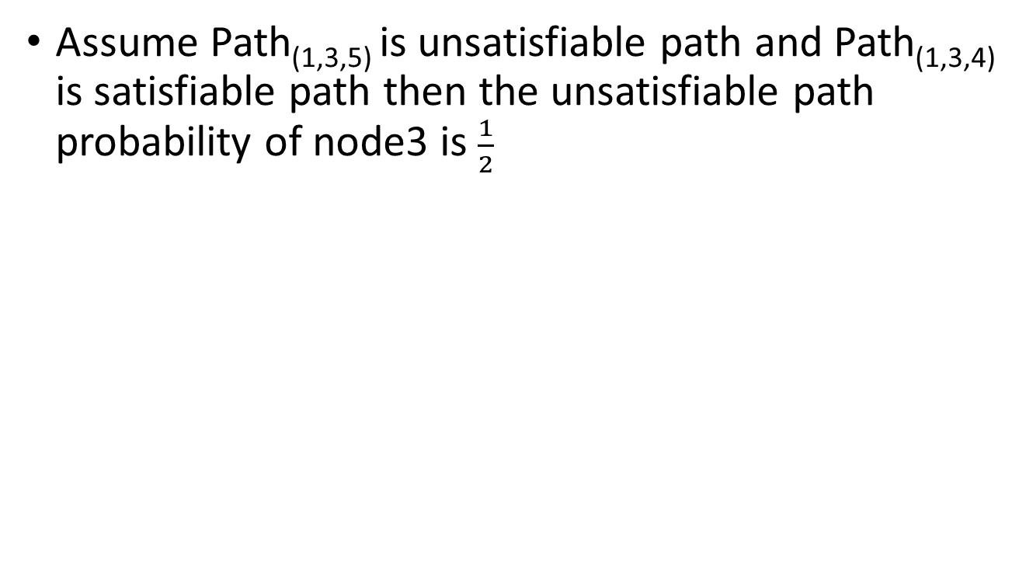
Example of node probability
Assume Path_{(1,3,5)} is unsatisfiable path and Path_{(1,3,4)} is satisfiable path then the unsatisfiable path probability of node3 is $\frac{1}{2}$

Slide 39
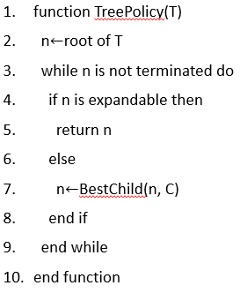
Selection
Start from root
Choose best child recursively
Find expandable node

Slide 40
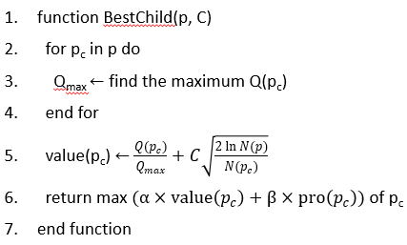
Selection – best child
Calculate the value by UCB1
Combination of value and probability
Find the best child by combination of those

Slide 41
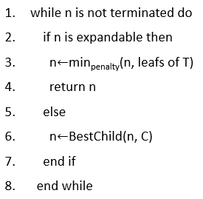
Expansion
Find the minimum penalty of expandable node

Slide 42
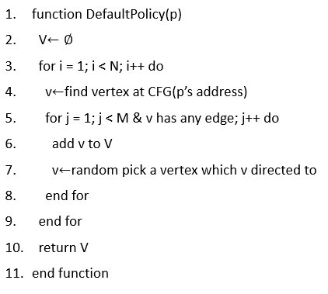
Simulation
Pick a path
Random pick an edge node of current path
cfg.get_any_node
Add into an array V

Slide 43
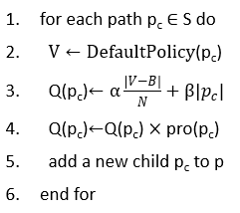
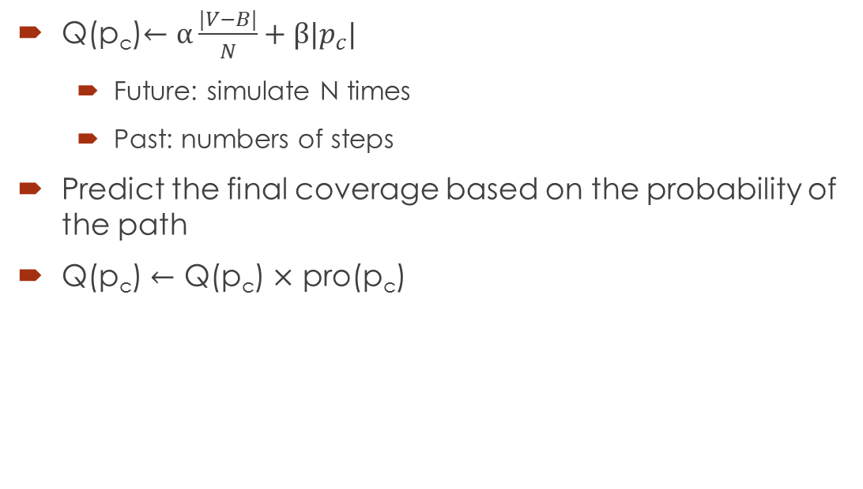
Coverage prediction
Q(p_{c})$←α\frac{|V−B|}{N}+β|­p_{c}|$
Future: simulate N times
Past: numbers of steps
Predict the final coverage based on the probability of the path
Q(p_{c}) $←$ Q(p_{c}) $×$ pro(p_{c})

Slide 44
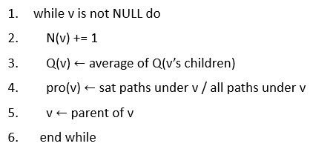
Backpropagation
Replace the information of its child
Coverage and probability

Slide 45
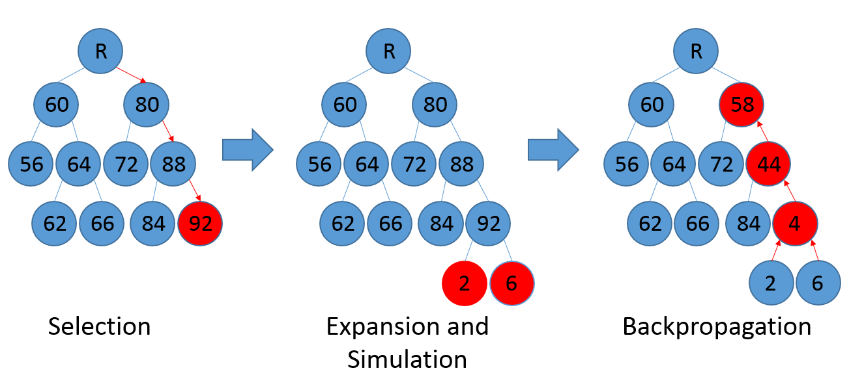
Example1
Update coverage

Slide 46
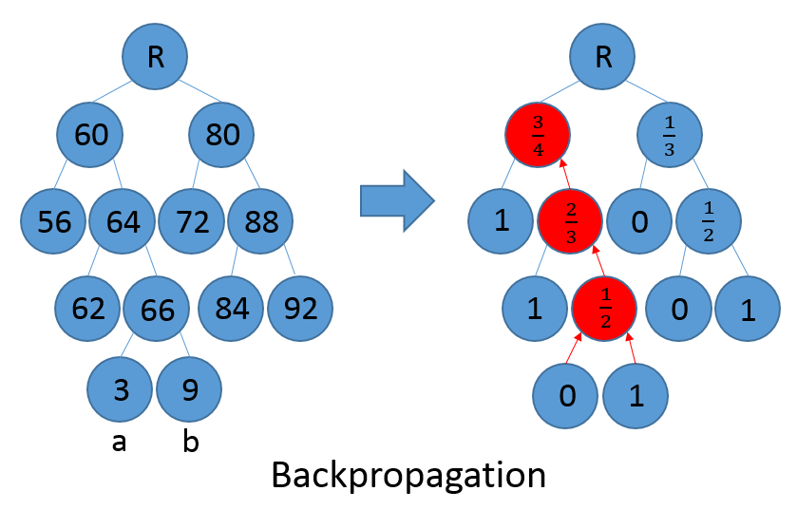
Example2
Update probability
a
b

Slide 47
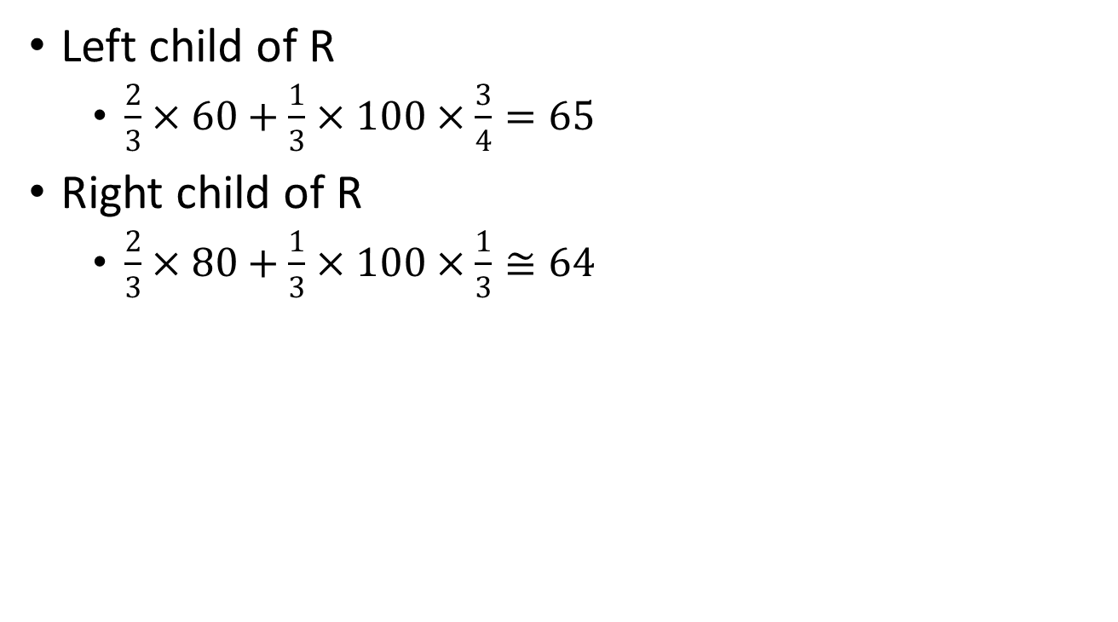
Find best child in example2
Left child of R
$\frac{2}{3}×60+\frac{1}{3}×100×\frac{3}{4}=65$
Right child of R
$\frac{2}{3}×80+\frac{1}{3}×100×\frac{1}{3}≅64$

Slide 48
Environment
OS
Ubuntu 16.04.2 LTS
CPU
Intel i7-2600K
RAM
24GB
Symbolic execution framework
angr

Slide 49
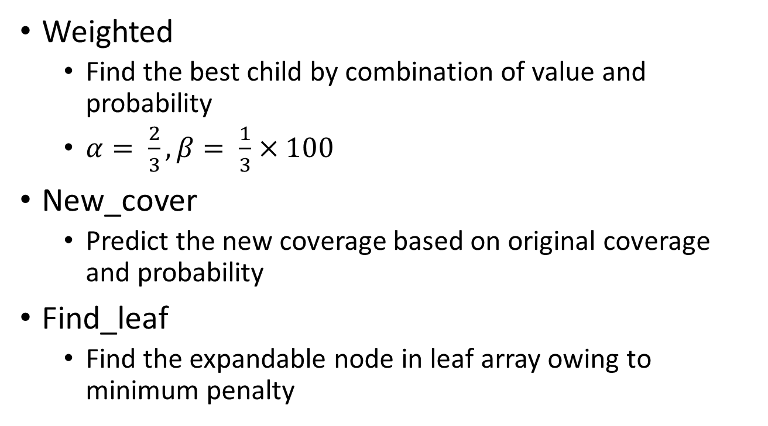
Three strategies
Weighted
Find the best child by combination of value and probability
$α= \frac{2}{3}, β= \frac{1}{3}×100$
New_cover
Predict the new coverage based on original coverage and probability
Find_leaf
Find the expandable node in leaf array owing to minimum penalty

Slide 50
Target program
8 GNU core utilities
Programs | Version | Source lines of code | Size
ls | 8.25 | 4413 | 154KB
cp | 8.25 | 1060 | 38.6KB
touch | 8.25 | 375 | 12.7KB
uname | 8.25 | 314 | 9.71KB
tail | 8.25 | 2166 | 76.4KB
stty | 8.25 | 2171 | 61.4KB
mv | 8.25 | 435 | 15.2KB
date | 8.25 | 549 | 17.7KB

Slide 51
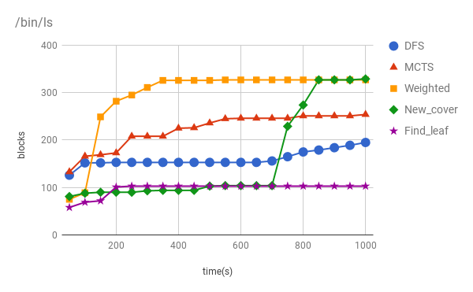
Line chart of ls

Slide 52
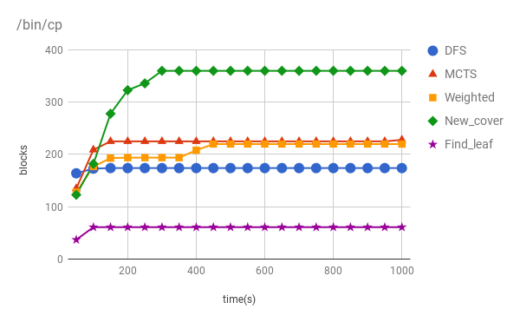
Line chart of cp

Slide 53
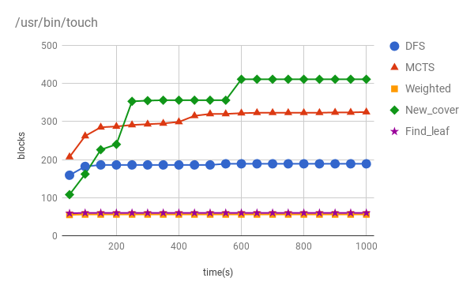
Line chart of touch

Slide 54
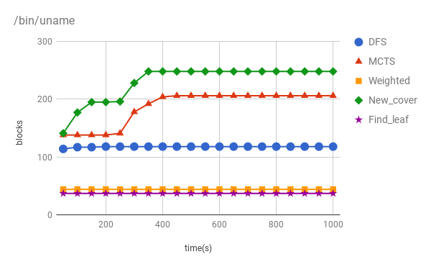
Line chart of uname

Slide 55
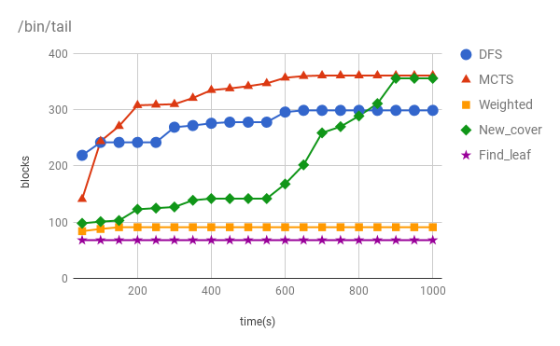
Line chart of tail

Slide 56
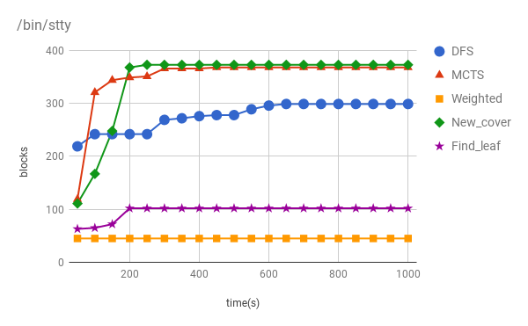
Line chart of stty

Slide 57
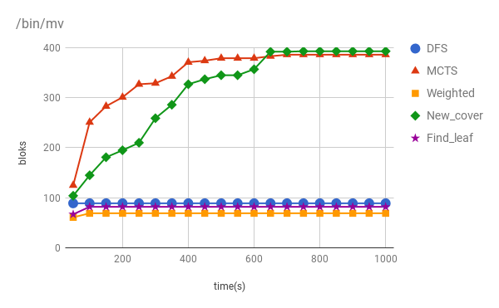
Line chart of mv

Slide 58
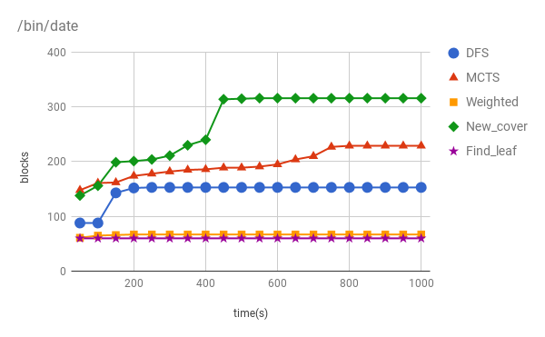
Line chart of date

Slide 59
AI of Security (II)
以人工智慧處理資訊安全議題 －
Fault Localization based on DNN inferred Input Data Dependency

Slide 60
Introduction
Traditional spectrum-base fault localization method:
It analyzes the execution paths of a program to determine which codes affect the execution results.
Program input is also an important key factor that influences execution results.
Can we observe the change of input and the change of coverage during each testing to find out where is the bug on the program?
Notes:
First I will introduce

Slide 61
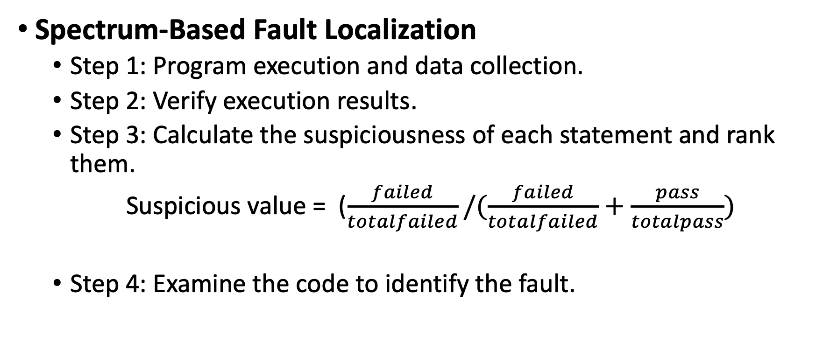
Background
Spectrum-Based Fault Localization
Step 1: Program execution and data collection.
Step 2: Verify execution results.
Step 3: Calculate the suspiciousness of each statement and rank them.
Suspicious value = ($\frac{failed}{totalfailed}/(\frac{failed}{totalfailed}+\frac{pass}{totalpass})$
Step 4: Examine the code to identify the fault.
Notes:
nomerator

Slide 62
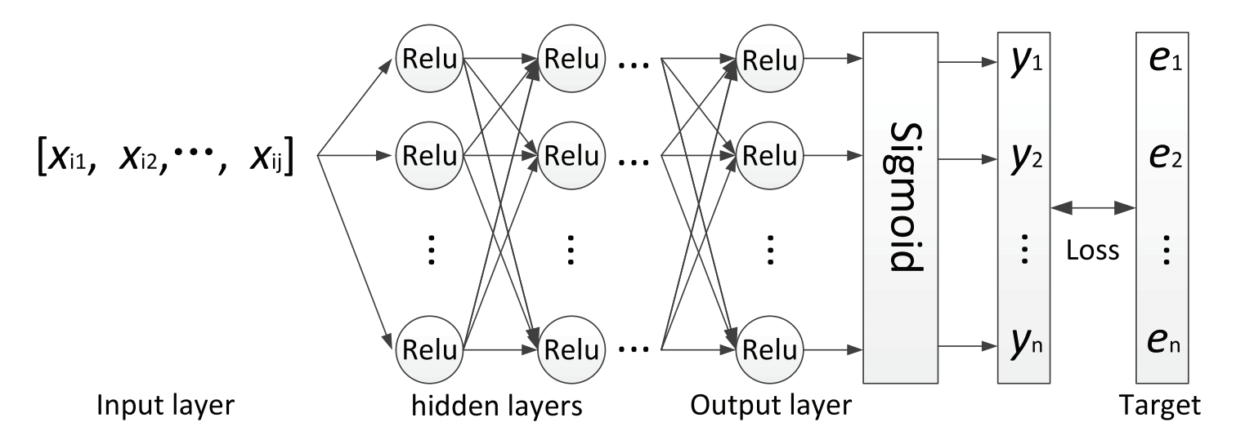
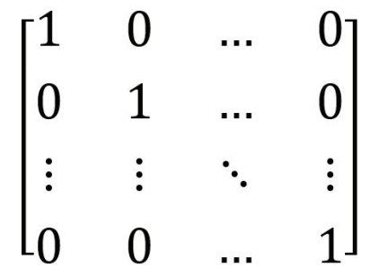
Background
Deep Neural Network Fault Localization
Virtual Test cases

Slide 63
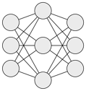
Flow
Program Input vector Model1 Model2 Report

Slide 64
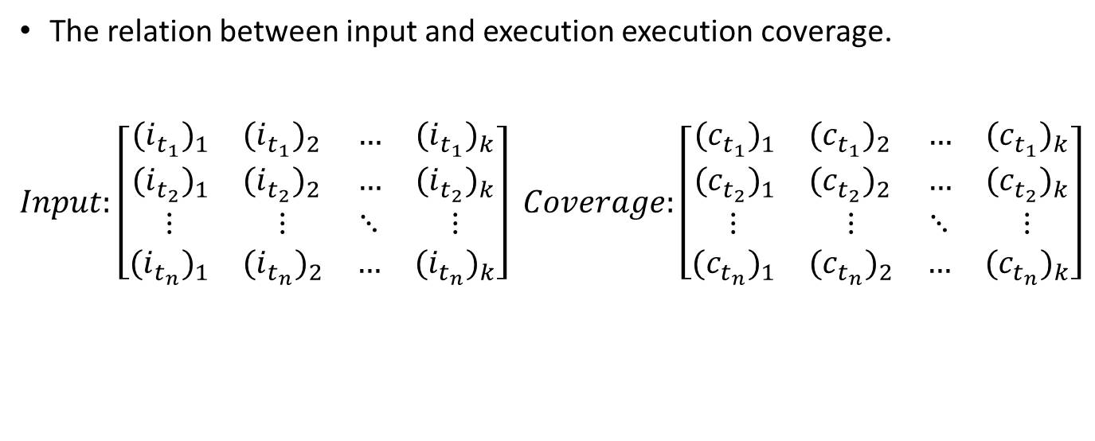
Model1
The relation between input and execution execution coverage.
$Input:$ $\left[\begin{matrix}\begin{matrix}{{(i}_{t_{1}})}_{1} & {{(i}_{t_{1}})}_{2} \\ {{(i}_{t_{2}})}_{1} & {{(i}_{t_{2}})}_{2}\end{matrix} & \begin{matrix}… & {{(i}_{t_{1}})}_{k} \\ … & {{(i}_{t_{2}})}_{k}\end{matrix} \\ \begin{matrix}⋮ & ⋮ \\ {{(i}_{t_{n}})}_{1} & {{(i}_{t_{n}})}_{2}\end{matrix} & \begin{matrix}⋱ & ⋮ \\ … & {{(i}_{t_{n}})}_{k}\end{matrix}\end{matrix}\right]$ $Coverage:\left[\begin{matrix}\begin{matrix}{{(c}_{t_{1}})}_{1} & {{(c}_{t_{1}})}_{2} \\ {{(c}_{t_{2}})}_{1} & {{(c}_{t_{2}})}_{2}\end{matrix} & \begin{matrix}… & {{(c}_{t_{1}})}_{k} \\ … & {{(c}_{t_{2}})}_{k}\end{matrix} \\ \begin{matrix}⋮ & ⋮ \\ {{(c}_{t_{n}})}_{1} & {{(c}_{t_{n}})}_{2}\end{matrix} & \begin{matrix}⋱ & ⋮ \\ … & {{(c}_{t_{n}})}_{k}\end{matrix}\end{matrix}\right]$

Slide 65
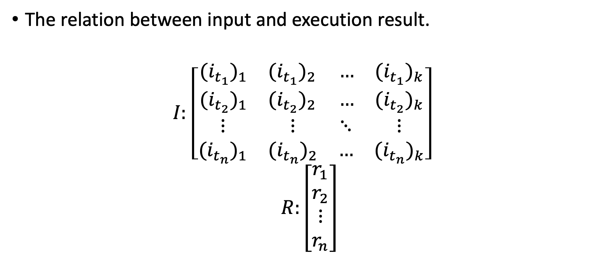
Model2
The relation between input and execution result.
$I:$ $\left[\begin{matrix}\begin{matrix}{{(i}_{t_{1}})}_{1} & {{(i}_{t_{1}})}_{2} \\ {{(i}_{t_{2}})}_{1} & {{(i}_{t_{2}})}_{2}\end{matrix} & \begin{matrix}… & {{(i}_{t_{1}})}_{k} \\ … & {{(i}_{t_{2}})}_{k}\end{matrix} \\ \begin{matrix}⋮ & ⋮ \\ {{(i}_{t_{n}})}_{1} & {{(i}_{t_{n}})}_{2}\end{matrix} & \begin{matrix}⋱ & ⋮ \\ … & {{(i}_{t_{n}})}_{k}\end{matrix}\end{matrix}\right]$
$R:\left[\begin{matrix}\begin{matrix}r_{1} \\ r_{2}\end{matrix} \\ \begin{matrix}⋮ \\ r_{n}\end{matrix}\end{matrix}\right]$

Slide 66
Important Byte
Q: Which byte from input that affect the execution result?
A: The maximum gradient of program input.
Failure input x₁ x₂ x₃ … x_{n}
1
Model1

Slide 67
Fault localization
Q: How important byte affect execution coverage.
A:
The gradient of important byte on Model2.
Which program line affect most when change important byte?
Notes:
找出import byte 後即可透過model2 找尋 當這些import byte 改變時 execution line 的改變量

Slide 68
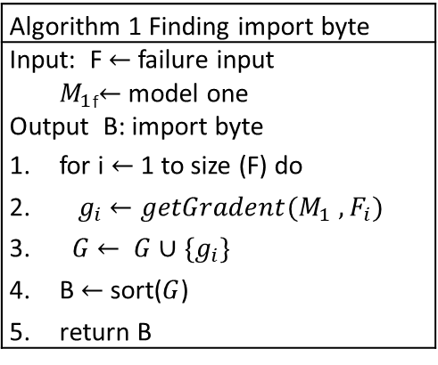
Algorithm
Algorithm 1 Finding import byte
Input: F $←$ failure input ${ M}_{1}$_{f}$←$ model one Output B: import byte for i $←$ 1 to size (F) do ${ g}_{i}$ $←getGradent(M_{1} , F_{i})$ $G$ $← G∪\{g_{i}\}$ B $←$ sort($G$) return B

Slide 69

Algorithm
Algorithm 2 Ranking suspiciousness of statement
Input: B $←$ import byte L $←$ program statement ${ M}_{2}$_{f}$←$model two Output R: ranking report for i $←$ 1 to size(B) do for j $←$ 1 to size (L) do ${ g}_{i}$ $←getGradent(M_{2} , L_{i ,} , B_{i} )$ R $← R∪\{g_{i}\}$ R $←$ sort(R) return R

Slide 70
Case Study
Get median | input line | T1 | T2 | T3 | T4 | T5 | T6 | T7
 |  | 2,3,4 | 3,2,4 | 3,3,4 | 4,3,4 | 5,4,1 | 3,4,1 | 1 4 2
1 Mid(x , y , z){ | s1 | 1 | 1 | 1 | 1 | 1 | 1 | 1
2 int m=z; | s2 | 1 | 1 | 1 | 1 | 1 | 1 | 1
3 if(y < z){ | s3 | 1 | 1 | 1 | 1 | 1 | 1 | 1
4 if(x < y){ | s4 | 1 | 0 | 0 | 1 | 0 | 0 | 0
5 m=y; | s5 | 1 | 0 | 0 | 0 | 0 | 0 | 0
6 }else if(x < z){ | s6 | 0 | 1 | 1 | 1 | 0 | 0 | 0
7 m=y //bug m should equal to x | s7 | 0 | 1 | 1 | 0 | 0 | 0 | 0
8 } | s8 | 1 | 1 | 1 | 1 | 0 | 0 | 0
9 }else{ | s9 | 0 | 0 | 0 | 0 | 1 | 1 | 1
10 if(x > y){ | s10 | 0 | 0 | 0 | 0 | 1 | 1 | 0
11 m=y; | s10 | 0 | 0 | 0 | 0 | 1 | 0 | 0
12 }else if(x > z){ | s12 | 0 | 0 | 0 | 0 | 0 | 1 | 0
13 m=x; | s13 | 0 | 0 | 0 | 0 | 0 | 1 | 0
14 } | s14 | 0 | 0 | 0 | 0 | 1 | 1 | 0
15 } | s15 | 0 | 0 | 0 | 0 | 1 | 1 | 1
16 cout<<m; | s16 | 1 | 1 | 1 | 1 | 1 | 1 | 1
17 } | s17 | 1 | 1 | 1 | 1 | 1 | 1 | 1
Pass/Fail Status |  | 1 | 0 | 1 | 1 | 1 | 1 | 1

Slide 71

Model one
$Input Matrix =\left[\begin{matrix}\left[32,20,33,20,34\right] \\ \left[33,20,32,20,34\right] \\ \begin{matrix}\left[33,20,33,20,34\right] \\ \left[34,20,33,20,34\right] \\ \begin{matrix}\left[35,20,34,20,31\right] \\ \left[33,20,34,20,31\right] \\ \left[31,20,34,20,32\right]\end{matrix}\end{matrix}\end{matrix}\right]$Output Matrix1 = [1,0,1,1,1,1,1]
Execution result
String to ascii byte

Slide 72

Model two
$Input =\left[\begin{matrix}\left[32,20,33,20,34\right] \\ \left[33,20,32,20,34\right] \\ \begin{matrix}\left[33,20,33,20,34\right] \\ \left[34,20,33,20,34\right] \\ \begin{matrix}\left[35,20,34,20,31\right] \\ \left[33,20,34,20,31\right] \\ \left[31,20,34,20,32\right]\end{matrix}\end{matrix}\end{matrix}\right] Output Matrix =\left[\begin{matrix}\left[1,1,1,1,1,0,0,1,0,0,0,0,0,0,0,0,1\right] \\ \left[1,1,1,0,0,1,1,1,0,0,0,0,0,0,0,1,1\right] \\ \begin{matrix}\left[1,1,1,0,0,1,1,1,0,0,0,0,0,0,0,1,1\right] \\ \left[1,1,1,1,0,1,0,1,0,0,0,0,0,0,0,1,1\right] \\ \begin{matrix}\left[1,1,1,0,0,0,0,0,1,1,1,0,0,1,1,1,1\right] \\ \left[1,1,1,0,0,0,0,0,1,1,0,1,1,1,1,1,1\right] \\ \left[1,1,1,0,0,0,0,0,1,0,0,0,0,0,1,1,1\right]\end{matrix}\end{matrix}\end{matrix}\right]$

Slide 73
Important byte
byte | 0 | 1 | 2 | 3 | 4
gradient | 0.615 | 0.224 | 0.89 | 0.353 | 0.713

Slide 74

Gradient on each statement
Get median
1 Mid(x , y , z){
2 int m=z;
3 if(y < z){
4 if(x < y){
5 m=y;
6 }else if(x < z){
7 m=y //bug m should equal to x
8 }
9 }else{
10 if(x > y){
11 m=y;
12 }else if(x > z){
13 m=x;
14 }
15 }
16 cout<<m;
17 }
Line | s4 | s5 | s6 | s7 | s10 | s11 | s12 | s13
$$∇$$ | 0.0141 | -0.9592 | 0.9927 | 0.9829 | -0.013 | 0.0003 | -0.0571 | -0.0001
Notes:
S6 S7錯誤位置

Slide 75
The process of fault localization
Compile the unmodified version and the wrong version of the program.
Next, we generate 100 testcases based on the failure testcase form siemens suite.
Let the program execute the generated test and compare the output of the non-modify program and the faulty program to obtain the final execution result.

Slide 76
The process of fault localization
According to the execution report generated by Gcov, we will collect the coverage path of the program.
Then, we convert the program input and program execution results and the program coverage path into input vectors for the next learning.
Finally, based on the output of the neural network, we sort each suspicious value of the code statement to find the location of the bug.

Slide 77
Benchmark (Siemens suite)
Program | Description | Number of faulty versions | Loc
print_tokens | Lexical analyzer | 7 | 565
print_tokens2 | Lexical analyzer | 10 | 510
replace | Pattern replacement | 32 | 563
schedule | Priority scheduler | 9 | 412
schedule2 | Priority scheduler | 10 | 307
tcas | Altitude separation | 41 | 173
tot_info | Information measure | 23 | 406

Slide 78

Compare to BPNN
Our
BPNN
The percentage of code need to be checked
Total 78

Slide 79
Exam Score
BPNN

Slide 80

Compare to D*
D* best
Our
D* worst
The percentage of code need to be checked
Total 78

Slide 81
Exam Score
82.3%
73.4%
36.7%

Slide 82
Summary
We propose a fault localization method based on DNN with input data dependency.
Not just using coverage information but also input information to help DNN model to locate the bug.
The result shows that our method is batter than other state-of-the-art method.

Slide 83
Security of AI (I)
人工智慧的安全議題 –
Revealing the Vulnerabilities of CNN

Slide 84
Motivation
Few testing method to Deep Learning system
To assure a Deep Learning system is reliable
A disaster might happen when a Deep Learning system fails, so detect the bugs of Deep Learning system is important.

Slide 85
Motivation
Bug : The label somehow is easier to be “Targeted” in source-target attack than other labels.

Slide 86

Methodology - Overview
Critical Pixels
Generating Adversarial Examples
Retrain models

Slide 87
Critical Pixels
Pixels that affect the prediction result the most.

Slide 88






Critical Pixels
$B$IM
Combine
$$ITC$$
$$0.5230$$
$0.$1224

Slide 89


Generating adversarial examples
Momentum Iterative FGSM (BIM with momentum)
Momentum Iterative Target Class Method

Slide 90
Retrain models
Append the adversarial examples which generated by our method in the training set. Then we adjust the learning rate and train the model again.

Slide 91
Experiment setup
Target Models:
VGG19
ResNet18
ResNeXt29-2x64d
EfficientNetB0

Slide 92
Experiment setup
Parameters:
Number of points: 5
Two for M-BIM
Three for M-ITC
Number of iteration of mutation: 7
Both attack iterate for 7 times

Slide 93

Experiment setup
Iteration
Attack in a class

Slide 94
Experiment setup
Pixels
Attack in a class
BIM Pixels
plus one ITC pixel | Misclassification Rate | Source-Target Rate
1 | 47.05% | 7.42%
2 | 65.30% | 10.26%
3 | 73.86% | 11.91%
4 | 78.58% | 13.32%
5 | 81.14% | 14.30%
6 | 82.47% | 14.21%
7 | 83.62% | 14.10%
8 | 84.45% | 13.71%
9 | 85.25% | 13.30%
10 | 85.76% | 12.37%
ITC Pixels
plus one BIM pixel | Misclassification Rate | Source-Target Rate
1 | 47.05% | 7.42%
2 | 52.47% | 11.10%
3 | 56.34% | 14.39%
4 | 60.35% | 17.90%
5 | 63.73% | 21.88%
6 | 66.02% | 24.78%
7 | 68.40% | 27.96%
8 | 69.96% | 30.42%
9 | 71.70% | 32.45%
10 | 72.79% | 33.88%

Slide 95
Experiment setup
What we choice is
Pixels | Misclassification Rate | Source-Target Rate
5 BIM | 80.64% | X
5 ITC | 41.42% | 16.82%
1 ITC + 4 BIM | 78.58% | 13.32%
4 ITC + 1 BIM | 60.35% | 17.90%
3 ITC + 2 BIM | 69.33% | 17.21%

Slide 96
Experiment setup
The order of attack is important
 | Misclassification Rate | Source-Target Rate
BIM before ITC | 44.94% | 17.15%
BIM after ITC | 69.33% | 17.21%

Slide 97


Slide 98

Results
Accuracy - Before and after retraining

Slide 99
Results
Source-Target successful rate in seen data
 | Airplane | Automobile | Bird | Cat | Deer | Dog | Frog | Horse | Ship | Truck
VGG19 | 17.21% | 24.52% | 15.87% | 61.64% | 1.67% | 4.42% | 0.44% | 3.87% | 0.85% | 2.00%
Retrained | 7.01% | 6.13% | 12.49% | 6.37% | 2.33% | 5.37% | 1.14% | 2.35% | 0.33% | 1.19%
ResNet18 | 45.25% | 6.40% | 18.15% | 14.72% | 2.40% | 1.57% | 2.41% | 1.26% | 1.45% | 1.46%
Retrained | 4.85% | 1.03% | 4.47% | 1.37% | 0.37% | 1.16% | 0.32% | 0.87% | 0.40% | 0.39%
ResNeXt29_2x64d | 10.10% | 0.91% | 3.26% | 6.69% | 4.05% | 2.48% | 0.62% | 1.54% | 1.05% | 1.77%
Retrained | 0.40% | 0.07% | 0.40% | 0.51% | 0.13% | 0.37% | 0.09% | 0.10% | 0.04% | 0.06%
EfficientNetB0 | 11.16% | 2.86% | 9.74% | 7.27% | 2.61% | 2.41% | 1.98% | 3.29% | 1.66% | 2.20%
Retrained | 2.26% | 0.57% | 2.24% | 1.44% | 0.55% | 0.89% | 0.52% | 1.19% | 0.36% | 0.59%

Slide 100
Results
Source-Target successful rate in unseen data
 | Airplane | Automobile | Bird | Cat | Deer | Dog | Frog | Horse | Ship | Truck
VGG19 | 12.67% | 24.89% | 13.13% | 57.01% | 0.70% | 3.98% | 0.36% | 2.51% | 0.34% | 0.99%
Retrained | 9.01% | 6.49% | 12.36% | 7.49% | 1.90% | 6.11% | 1.15% | 2.31% | 0.56% | 1.75%
ResNet18 | 37.08% | 5.34% | 11.01% | 8.96% | 0.74% | 1.19% | 0.99% | 0.78% | 0.37% | 0.50%
Retrained | 6.43% | 1.56% | 5.12% | 2.31% | 0.44% | 2.26% | 0.58% | 0.97% | 0.49% | 0.62%
ResNeXt29_2x64d | 7.64% | 1.26% | 2.53% | 4.11% | 1.45% | 1.91% | 0.40% | 1.18% | 0.39% | 0.84%
Retrained | 1.28% | 0.40% | 1.26% | 1.50% | 0.37% | 0.93% | 0.20% | 0.34% | 0.19% | 0.31%
EfficientNetB0 | 10.38% | 3.84% | 8.83% | 4.95% | 1.39% | 2.55% | 1.49% | 2.65% | 0.92% | 1.44%
Retrained | 3.22% | 1.13% | 3.56% | 2.62% | 0.91% | 1.89% | 0.91% | 1.42% | 0.67% | 0.93%

Slide 101
Results
Misclassification rate in seen data
 | Airplane | Automobile | Bird | Cat | Deer | Dog | Frog | Horse | Ship | Truck
VGG19 | 69.33% | 73.93% | 69.05% | 76.02% | 66.00% | 67.42% | 66.20% | 67.46% | 66.55% | 68.03%
Retrained | 28.83% | 30.19% | 27.63% | 27.52% | 25.30% | 26.59% | 24.74% | 27.25% | 24.58% | 28.59%
ResNet18 | 59.93% | 56.52% | 53.36% | 51.74% | 46.01% | 45.98% | 46.10% | 48.46% | 47.15% | 48.19%
Retrained | 11.68% | 10.94% | 9.78% | 9.04% | 8.62% | 9.46% | 8.73% | 10.13% | 10.28% | 10.40%
ResNeXt29_2x64d | 22.64% | 20.97% | 18.26% | 20.38% | 18.24% | 18.73% | 16.14% | 18.85% | 17.64% | 20.09%
Retrained | 1.88% | 2.03% | 1.69% | 1.87% | 1.41% | 1.68% | 1.47% | 2.08% | 1.82% | 2.06%
EfficientNetB0 | 30.33% | 29.15% | 26.92% | 26.29% | 23.10% | 25.53% | 22.12% | 27.29% | 25.56% | 28.27%
Retrained | 7.67% | 7.43% | 6.88% | 6.13% | 5.53% | 5.98% | 5.79% | 6.90% | 6.63% | 7.22%

Slide 102
Results
Misclassification rate in unseen data
 | Airplane | Automobile | Bird | Cat | Deer | Dog | Frog | Horse | Ship | Truck
VGG19 | 64.95% | 70.10% | 64.60% | 71.62% | 61.42% | 63.44% | 61.08% | 62.60% | 61.81% | 63.99%
Retrained | 31.54% | 32.26% | 29.95% | 29.44% | 26.71% | 28.93% | 26.73% | 29.73% | 26.18% | 30.55%
ResNet18 | 47.67% | 45.17% | 40.77% | 39.77% | 35.75% | 35.64% | 35.99% | 36.57% | 36.73% | 37.75%
Retrained | 14.82% | 14.29% | 13.24% | 11.84% | 10.19% | 12.10% | 11.98% | 12.24% | 12.57% | 13.48%
ResNeXt29_2x64d | 15.95% | 15.14% | 12.61% | 13.95% | 12.52% | 13.96% | 11.34% | 13.51% | 12.49% | 13.87%
Retrained | 4.97% | 4.87% | 4.73% | 4.47% | 4.10% | 4.53% | 4.47% | 4.95% | 4.66% | 4.83%
EfficientNetB0 | 26.47% | 25.39% | 24.23% | 22.83% | 19.71% | 23.08% | 20.45% | 23.66% | 21.68% | 24.60%
Retrained | 11.21% | 10.81% | 10.20% | 9.65% | 8.21% | 9.91% | 9.22% | 10.28% | 10.37% | 10.55%

Slide 103

Results

Slide 104

Results

Slide 105

Results

Slide 106

Results

Slide 107


Slide 108

Results
FGSM – Before and after retraining

Slide 109
Summary
Our adversarial attack reveals weakness of image recognition models.
Experiments show that adversarial examples generated by our method are good at fixing weaknesses by retraining assailable models with them.

Slide 110
Security of AI (II)
人工智慧的安全議題 –
藉由符號執行操控深度神經網路標籤與錯誤分類攻擊測試

Slide 111
藉由符號執行
操控深度神經網路標籤與錯誤分類攻擊測試
Testing DNN Source Target Misclassification
with Symbolic Execution

Slide 112



研究動機
深度神經網路
符號執行
精確分析
對抗例
混淆輸出標籤 (!6)
操控輸出標籤 (=0)

Slide 113
自動化軟體測試技術
符號執行 (Symbolic execution)
收集限制式，求解器求解
精確值
模糊測試 (Fuzzing)
根據變異隨意產生
隨機值
擬真執行 (Concolic execution)
反向限制式
避免無謂路徑探索，仍要求解

Slide 114

對抗例
對抗攻擊
加入擾動 (perturbation)
影響標籤
實際案例稱對抗例

Slide 115

對抗例威脅模型分類法

Slide 116
相關研究
名稱 | FGSM | JSMA | DeepCheck | DeepConcolic | 我們的方法
方法 | 基於數學 | 基於數學 | 基於軟體分析 | 基於軟體分析 | 基於軟體分析
對抗攻擊目標 | 分類錯誤 | 指定來源 操控分類錯誤 | 分類錯誤 | 分類錯誤 | 指定來源 操控分類錯誤

Slide 117

研究方法
轉換深度神經網路
找尋重要像素點
利用符號執行測試生成像素值
生成對抗例圖片與驗證結果

Slide 118


研究方法 - 轉換深度神經網路
浮點數型態轉換
驗證階段，略過最後一層激勵層
訓練階段
驗證階段

Slide 119

找尋重要像素點
找尋目標
降低原始標籤機率
升高指定標籤機率
找尋方法
梯度
W
W+b
計算策略
正數: 提升標籤機率
負數: 降低標籤機率
絕對值: 不論正數值

Slide 120
找尋重要像素點
重要像素點預期效果分析表
操控像素點數量 | 所有像素點配對 | 重要像素點 總體策略配對 | 加速倍率
1 | C₁⁷⁸⁴=784 | 36 | 22
2 | C₂⁷⁸⁴=306936 | 36 | 8526
4 | C₄⁷⁸⁴=1.56E+10 | 36 | 4.34E+08
6 | C₆⁷⁸⁴=3.16399E+14 | 36 | 8.79E+12

Slide 121

利用符號執行生成像素值
原始圖片: pixel
神經網路: network
操控標籤: desire_label

Slide 122
生成對抗例圖片與驗證結果
生成圖片
重新輸入進深度神經網路
驗證結果
對原始深度神經網路
浮點數
激勵層(activation layer)

Slide 123
實驗資料
深度神經網路架構
資料集：Mnist-10
手寫數字辨識分類
分類結果：0~9
圖片尺寸： 28*28 = 784
256 色灰階
名稱 | 隱藏層 層數 | 隱藏層神經網路 神經元數量 | 隱藏層 神經網路架構 | 整體 深度神經網路架構
模型1 | 1 | 10 | 10 | 784*10*10*10
模型2 | 1 | 5 | 5 | 784*5*10*10
模型3 | 2 | 10 | 10*10 | 784*10*10*10*10
模型4 | 2 | 5 | 5*5 | 784*5*5*10*10

Slide 124

深度神經網路架構

Slide 125

深度神經網路準確率 - 隱藏層層數
名稱 | 隱藏層層數 | 隱藏層 神經元數量 | 隱藏層架構 | 模型準確度
模型1 | 1 | 10 | 10 | 0.9251
模型2 | 1 | 5 | 5 | 0.895
模型3 | 2 | 10 | 10*10 | 0.9228
模型4 | 2 | 5 | 5*5 | 0.9023

Slide 126
各深度神經網路準確度比較表
名稱 | 隱藏層 層數 | 整體 深度神經網路 架構 | 樣本數量 | 模型準 確度 | 攻擊 成功率
模型１ | 1 | 784*10*10*10 | 500 | 0.926 | 0.983
模型２ | 1 | 784*5*10*10 | 100 | 0.905 | 0.833
模型３ | 2 | 784*10*10*10*10 | 500 | 0.924 | 0.988
模型４ | 2 | 784*5*5*10*10 | 100 | 0.904 | 0.959

Slide 127
操控深度神經網路標籤實驗 - 更動像素點比例(千分比)
 | 操控標籤
原 始 標 籤 |  | 0 | 1 | 2 | 3 | 4 | 5 | 6 | 7 | 8 | 9
 | 0 | 0 | 14 | 6 | 8 | 16 | 5 | 8 | 11 | 9 | 14
 | 1 | 19 | 0 | 4 | 3 | 14 | 5 | 7 | 6 | 6 | 7
 | 2 | 15 | 10 | 0 | 7 | 17 | 7 | 5 | 12 | 9 | 15
 | 3 | 10 | 7 | 7 | 0 | 14 | 6 | 8 | 8 | 10 | 12
 | 4 | 8 | 11 | 4 | 7 | 0 | 6 | 5 | 7 | 6 | 6
 | 5 | 9 | 9 | 6 | 8 | 11 | 0 | 6 | 11 | 4 | 11
 | 6 | 22 | 12 | 4 | 11 | 14 | 7 | 0 | 14 | 11 | 14
 | 7 | 13 | 14 | 6 | 4 | 15 | 8 | 11 | 0 | 9 | 8
 | 8 | 14 | 7 | 4 | 7 | 10 | 5 | 7 | 7 | 0 | 10
 | 9 | 13 | 11 | 7 | 5 | 5 | 5 | 7 | 6 | 6 | 0
Notes:
30/784 = 0.03826530612 = 38‰

Slide 128
操控深度神經網路標籤實驗 - 生成成功率
 | 操控標籤
原 始 標 籤 |  | 0 | 1 | 2 | 3 | 4 | 5 | 6 | 7 | 8 | 9
 | 0 | 0 | 1 | 1 | 1 | 0.89 | 1 | 1 | 1 | 1 | 0.95
 | 1 | 0.98 | 0 | 1 | 1 | 1 | 1 | 1 | 1 | 1 | 1
 | 2 | 0.99 | 1 | 0 | 1 | 0.82 | 1 | 1 | 0.93 | 0.99 | 0.87
 | 3 | 1 | 1 | 1 | 0 | 0.95 | 1 | 1 | 1 | 0.99 | 0.9
 | 4 | 0.99 | 1 | 1 | 1 | 0 | 1 | 1 | 1 | 1 | 1
 | 5 | 1 | 1 | 1 | 1 | 1 | 0 | 1 | 1 | 1 | 1
 | 6 | 0.85 | 1 | 1 | 1 | 1 | 1 | 0 | 1 | 0.99 | 0.95
 | 7 | 1 | 1 | 1 | 1 | 0.99 | 1 | 1 | 0 | 1 | 0.93
 | 8 | 0.97 | 1 | 1 | 1 | 1 | 1 | 1 | 1 | 0 | 0.99
 | 9 | 1 | 1 | 1 | 1 | 1 | 1 | 1 | 1 | 1 | 0

Slide 129
小結
利用符號執行操控深度神經網路標籤與錯誤分類攻擊測試
找尋重要像素點兩種目標
降低原始標籤機率
升高指定標籤機率
發現準確率與攻擊成功率沒有相關性

Slide 130
未來展望
套用自動化軟體分析技術於深度神經網路框架
優化取重要像素點
增進求解器速度
累計符號化變數
反向限制式
增強對抗攻擊能力
加大攻擊目標機率值
基於數學模型的攻擊減少擾動

Slide 131
結論
AI of Security
Security of AI
Applying in the NIST Security Framework

Slide 132
Q&A

